Slide 1
DAT - Class 1
Overview, Installation, Basic Concepts

Slide 2
Class Introduction
Overview
Take 10-15 Minutes to get introductions, assess people on basic assumptions about Data Science

Slide 3
Suggested Agenda
Time | Activity | Purpose
0:00 - 0:02 | Welcome | Introduce the lesson’s objectives and agenda.
0:02 - 0:10 | Activity 1 | Why?
0:10 - 0:25 | Activity 2 | Why?
0:25 - 0:30 | Summary | Wrap up the learning and share next steps.

Slide 4
Materials and Preparation
This is something instructors will need to do in advance of delivering this lesson.
This is something they’ll need to gather or provide.
This is some other important information they should know about in advance.
Be sure to link to any student-facing materials needed for this lesson on this slide.

Slide 5
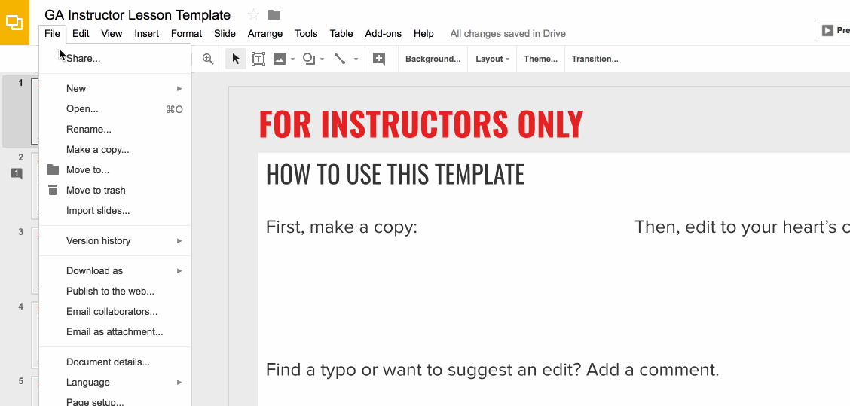
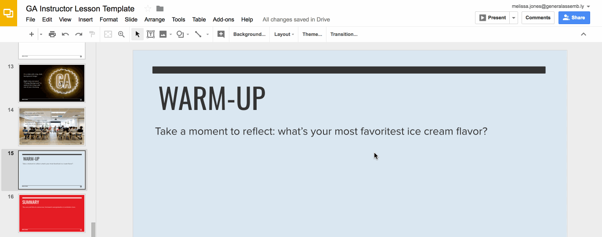
Preparation (Continued)
Ready to customize this lesson?
First things first, make a copy of this presentation. You’ll then be able to edit to your 💗’s content.
Find a typo or want to suggest an edit?
Add a comment. Our Product Advisory Board will review and incorporate your suggestions.

Slide 6
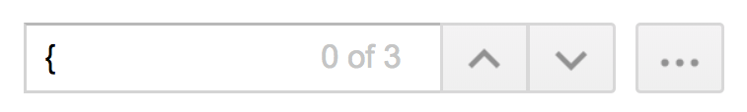
Preparation (Continued)
Remember to press Command F and do a search for instances of brackets in the deck. All instances of brackets denote places where instructors must fill in information/customize prior to presenting in class.

Slide 7
Differentiation and Extensions
This is a suggestion for a way in which instructors might change up this lesson to meet the needs of more advanced or less advanced students.
This is another suggestion.
This is another suggestion.
Be sure to link to any supplemental/optional materials on this slide.

Slide 8

Jonathan Bechtel
Data Science Instructor, General Assembly
Technical Lead, Kismet Analytics
Notes:
X MINUTES
TALKING POINTS
This is a suggested talking point.
This is another.
TEACHING TIPS
This is a suggestion for the instructor on something to do before, during or after presenting this slide.
This is another suggestion.

Slide 9
What About You?
What brought you here?
Career background?
What are you looking to get out of the class?
Notes:
X MINUTES
TALKING POINTS
This is a suggested talking point.
This is another.
TEACHING TIPS
This is a suggestion for the instructor on something to do before, during or after presenting this slide.
This is another suggestion.

Slide 10
Things You Should Have Installed:
Anaconda
A Github Account
A slack account w/ GA
Notes:
X MINUTES
TALKING POINTS
This is a suggested talking point.
This is another.
TEACHING TIPS
This is a suggestion for the instructor on something to do before, during or after presenting this slide.
This is another suggestion.

Slide 11
Class Format
GA DAT 06/24
Unit 1: Python Foundations. Lessons 1-4.
Unit 2: Data Analysis & Visualization. Lessons 5-9
Unit 3: Models & Prediction. 10-14
Unit 4: Applications. NLP, Time Series, etc. Lessons 15-19

Slide 12
What Is A Data Scientist?
What Is Your Working Definition of a Data Scientist?
Notes:
X MINUTES
TALKING POINTS
This is a suggested talking point.
This is another.
TEACHING TIPS
This is a suggestion for the instructor on something to do before, during or after presenting this slide.
This is another suggestion.

Slide 13
A Data Scientist Is Someone Who Knows More About Stats Than a Typical Programmer, and More About Programming Than a Typical Statistician
Notes:
X MINUTES
TALKING POINTS
This is a suggested talking point.
This is another.
TEACHING TIPS
This is a suggestion for the instructor on something to do before, during or after presenting this slide.
This is another suggestion.

Slide 14
Data Science Overview
Overview
Spend about 20 minutes or so on the slides, walk through them carefully, and when you’re finished with this section……...GO INTO THE JUPYTER NOTEBOOK.
Wrap up the section on Pandas, and take a 5-10 minute break.

Slide 15
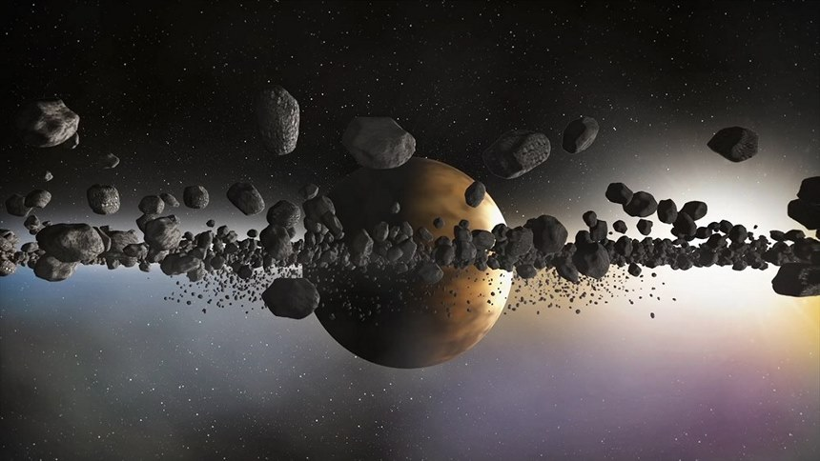
So What Skills Does a Data Scientist Have to Master?

Slide 16
Data Science Competencies
1). High Level Programming Language
2). Data Collection/Cleaning
3). Conceptual Fluency with the Statistical Techniques You Apply To Your Data

Slide 17
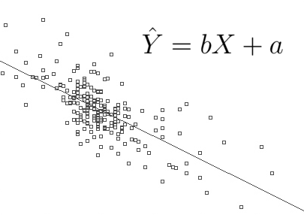
Statistical Competencies for Data Science
Descriptive statistics
Basic Understanding of distributions
Regression
Familiarity with different machine learning methods
Notes:
3-5 minutes
TALKING POINTS
Take a minute or two to discuss importance of each of these concepts

Slide 18
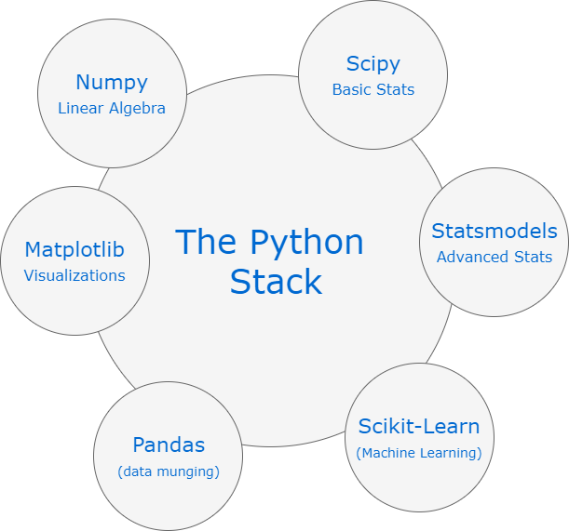
Notes:
Take about 5-7 minutes to over what each one of these libraries does.

Slide 19
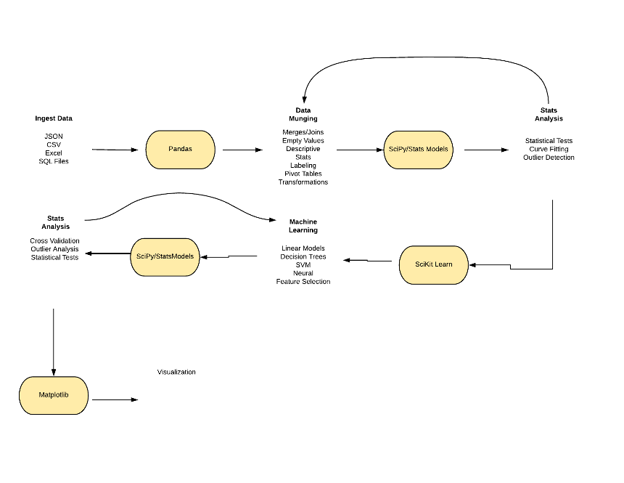
Notes:
This is an important slide -- walk through this diagram with the students, explaining what the concepts are.
Lots of people are looking for a clear understanding of what the DS process is, and this chart typically helps a lot.
After you are done……….have students open up the Jupyter notebook for this class, and work through the cells until you get to the scikit learn part.
Once you are done with this it’s usually time for a 5-10 minute break.

Slide 20
Machine Learning Overview
Overview
Spend about another 20 or so minutes on the slides. Emphasize the major concepts like the cost function, optimization, etc.
When you are finished, go back into the notebook, and finish out the cells.
This MIGHT take you to the end of the class depending on the tempo.

Slide 21
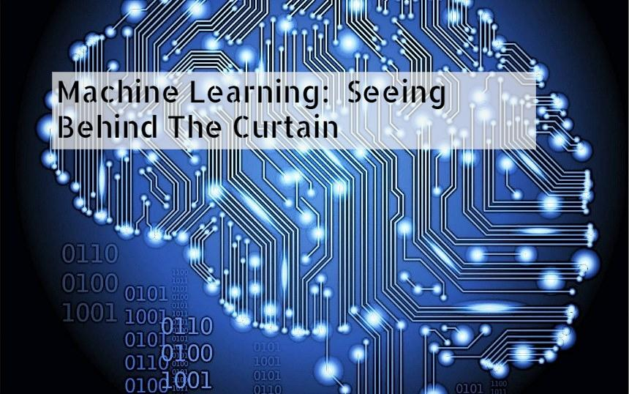

Slide 22
Defining Machine Learning
What Is Your Working Definition of Machine Learning?
Notes:
X MINUTES
TALKING POINTS
This is a suggested talking point.
This is another.
TEACHING TIPS
This is a suggestion for the instructor on something to do before, during or after presenting this slide.
This is another suggestion.

Slide 23
The Broader Notion of Building Statistical Artifacts That Become More Accurate Over Time Based on Experience
Charles Isbell, Computer Science Professor, Georgia Tech
Notes:
X MINUTES
TALKING POINTS
This is a suggested talking point.
This is another.
TEACHING TIPS
This is a suggestion for the instructor on something to do before, during or after presenting this slide.
This is another suggestion.

Slide 24
How Does Machine Learning Actually Get Its Work Done?

Slide 25
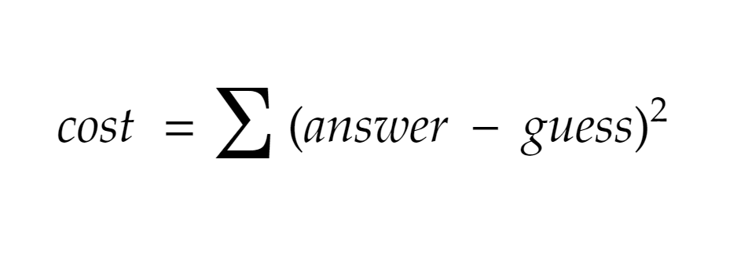
Notes:
Use this slide to briefly introduce people to the concept of the concept function, and the broader idea of machine learning optimization

Slide 26
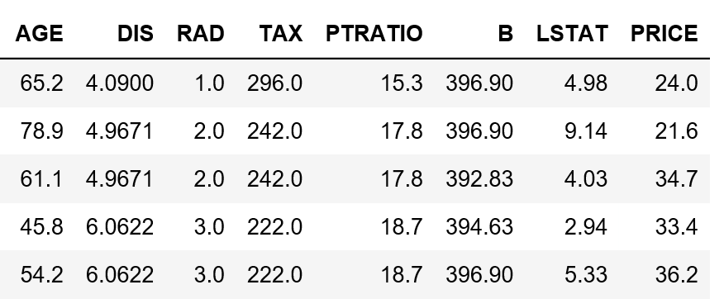

Slide 27
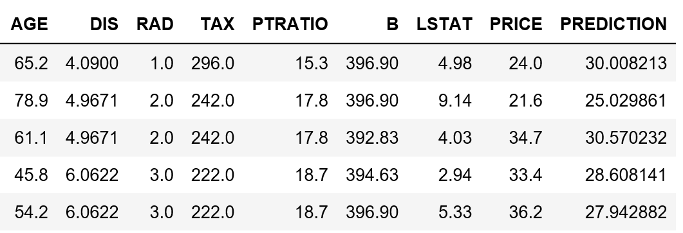
Notes:
Use this slide and the previous one to relate to the idea of what developing an ML hypothesis looks like in practice…….and once you’re done……...go back into the Jupyter Notebook and finish up the rest of the cells…...it walks you through how to build a basic model in sklearn.

Slide 28
Machine Learning Wrap Up
Overview
This is the last portion of the class. Adjust the tempo according to time.
Some classes might chew up the 2 hours by the time they get here, in that case…..just go straight to recommended reading sources.

Slide 29
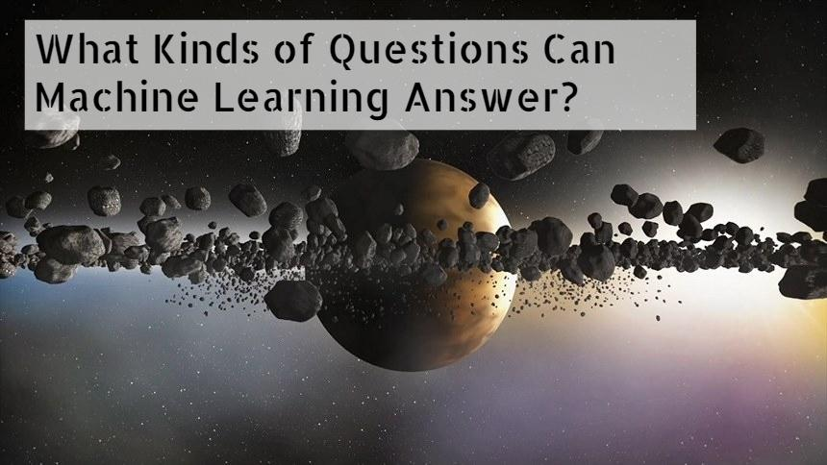

Slide 30
